Slide 1
2N® IP Verso 2.0 The world’s most modular intercom now with a FullHD camera

Slide 2
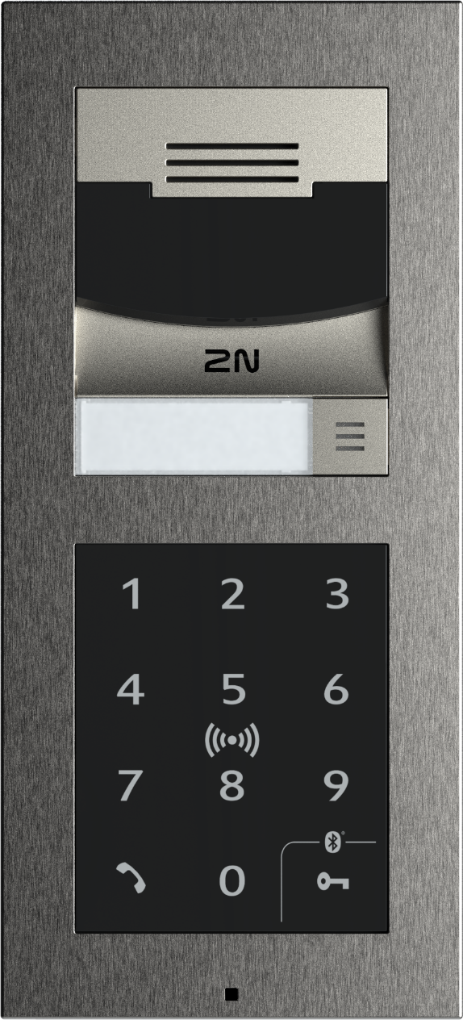
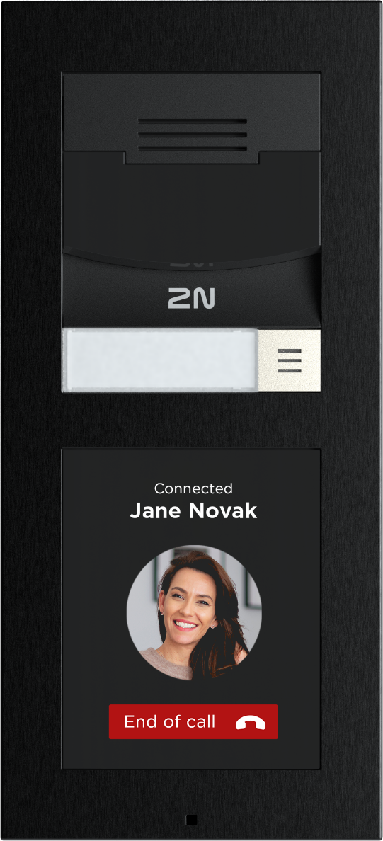
Why did we need a new one?
Customers like the modularity of the current 2N® IP Verso intercom, but the camera quality was limiting in some installations (50% of office projects and more and more residential ones require a Full HD camera).
Notes:
Our best selling intercom… customers love the modularity, but the only limitation in some installation is the quality of the camera.
We know from our research and studies that 50% of office projects require an intercom with a FullHD camera.
Therefore, we are ready to launch the next generation of our best-seller which is harder, better, faster, stronger.
These are the adjectives that characterize IP Verso 2.0 and on which we will build our marketing communications.

Slide 3
Highly durable chassis
Made of anodized aluminum, is super strong and holds its shape perfectly during installation
Eliminates heat from the processor
Eliminates the possibility of leakage into the intercom caused by poor installation
Laser-printed labels (IN, OUT, GND, etc.)
HARDER. Better. Faster. Stronger.
Notes:
Made of anodized aluminum, is super strong and holds its shape perfectly during installation, even on uneven surfaces, without a single dent.

Slide 4
Wide-angle Full HD camera
WDR-capable lens
Sun shining behind the visitor? The WDR-capable lens balances scenes with large variance between bright and dark areas: meaning no more black silhouettes.
Low light conditions
Whilst other cameras might need to switch to night mode at dusk, the 2N® IP Verso 2.0 maintains full image colour mere minutes before total darkness.
Face zooming (Q3/Q4, 2023)
Camera detects the face in the frame and zooms in - the user at the answering unit can clearly identify their visitor.
If another person steps into the view, the camera zooms out.
Harder. BETTER. Faster. Stronger.

Slide 5
Flexible access control
Speedy door entry thanks to 5 access methods
In addition to the RFID, PIN code, fingerprint and mobile access based on Bluetooth or NFC, the 2N® IP Verso 2.0 supports also QR codes
great, quick solution for one-time visits / temporary access
Harder. Better. FASTER. Stronger.

Slide 6
Powerful feature set
2N® IP Verso 2.0 is powered by the Axis ARTPEC-7 processor which provides power for both the camera and new features such as:
Face zooming
Advanced motion detection
Video analytics (intercom ignores ordinary background motion to reduce false alarms)
Zipstream (reduces Full HD streams’ bitrate by an average of 50% compared to H.264)
Harder. Better. Faster. STRONGER.

Slide 7
What remains unchanged?
Endless modularity (all the modules, frames, boxes and backplates remain fully compatible)
Installation options (on wall, flush, on glass)
IP54 & IK08 rating
Surface finishes (black or nickel colour)

Slide 8
Comparison table
FEATURES | 2N® IP Verso | 2N® IP Verso 2.0
Part numbers | 9155101/ 9155101B 9155101C / 9155101CB | 9155211C / 9155211CB
Camera resolution (in call) | 640 x 480 px (VGA) | 1920 x 1080 px (Full HD)
Max. viewing angle | 128°(H), 95°(V) | 138° (H), 105° (V)
WDR support | X | ✓
IR illumination | ✓ | ✓
Zipstream (video compression) | X | ✓
QR code access | X | ✓
ARTPEC-7 processor | X | ✓
Face Zooming | X | ✓ (Q4, 2023)
Chassis | Hardened plastic | Anodized aluminum
IN/OUT | 1x IN, 1x OUT, 1x NO/NC Relay | 1x IN, 1x OUT, 1x NO/NC Relay
IP & IK rating | IP54, IK08 | IP54, IK08

Slide 9
Harder. Better. Faster. Stronger. Offer your clients unparalleled flexibility, market-leading technology, and much more with the 2N® IP Verso 2.0.

